Slide 1
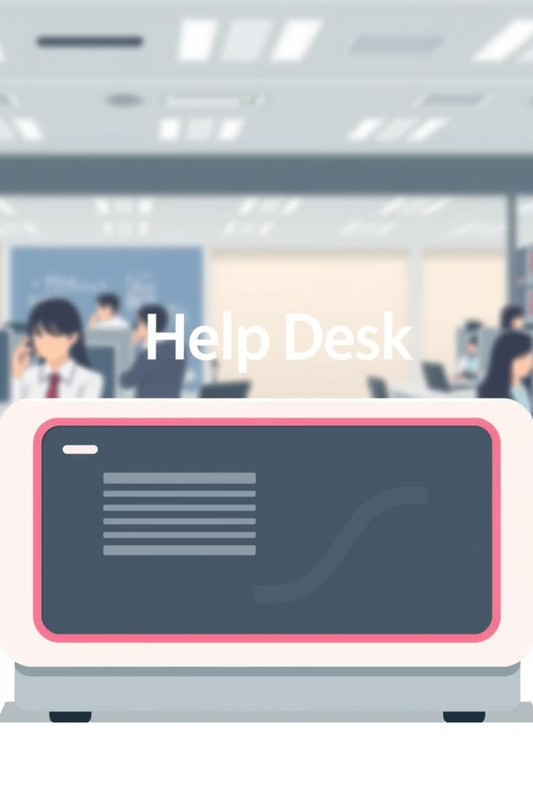
QuickDesk - Simplifying IT Support
Presented by: Harshit, Aditya, Varun, Sankalp
Date: August 2, 2025

Slide 2
Introduction to QuickDesk
QuickDesk is an intuitive, user-friendly help desk system designed to revolutionize IT support within organizations. It empowers users to effortlessly raise support tickets and provides support staff with robust tools to efficiently manage and resolve queries. Our primary goal is to streamline communication and enhance the overall support experience.

Slide 3
Addressing Real-World Support Challenges
1
Fragmented Processes
2
Lost Communications
Many organizations lack a structured support process, leading to inefficiencies and dropped issues.
Queries often get buried in overwhelming email inboxes, making tracking and follow-up nearly impossible.
3
Lack of Transparency
4
No Historical Data
Without a centralized system, there's no clear way to track ticket progress or user feedback.
Absence of user feedback or historical data hinders continuous improvement and problem resolution.
QuickDesk centralizes and structures ticketing, ensuring no query is lost and every issue is addressed systematically.

Slide 4
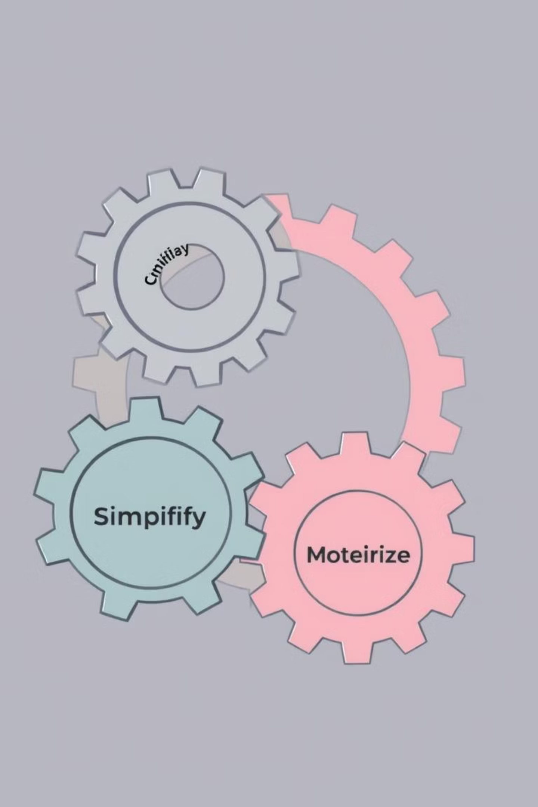
The Core Purpose of QuickDesk
QuickDesk simplifies support operations, enhancing transparency and communication. It provides a modern, intuitive interface that benefits all users by making the support process clear and efficient.

Slide 5



Diverse User Roles in QuickDesk
End Users
Support Agents
Administrators
Create new support tickets
Receive and resolve tickets
Manage user roles and permissions
Track the status of their requests
Provide timely updates
Categorize and prioritize tickets
View past interactions
Communicate with users
Oversee system performance

Slide 6






Key Functional Requirements
User Authentication
Ticket Lifecycle Management
Secure registration and login for all user types.
Comprehensive tracking from 'Open' to 'Closed' status.
Search and Filtering
Integrated Commenting
Efficient tools for finding and organizing tickets.
Streamlined communication within ticket threads.
Admin Category Control
Automated Email Alerts
Administrators can manage and customize ticket categories.
Timely notifications for ticket updates and status changes.

Slide 7





Streamlined User Flow
1. User Login
Secure access to the QuickDesk portal.
2. Submit Ticket
Users detail their issues via a simple form.
3. Agent Updates
Support agents provide progress and solutions.
4. Notification Sent
Automated alerts keep users informed.
5. Resolved/Closed
Issue successfully addressed and ticket finalized.

Slide 8
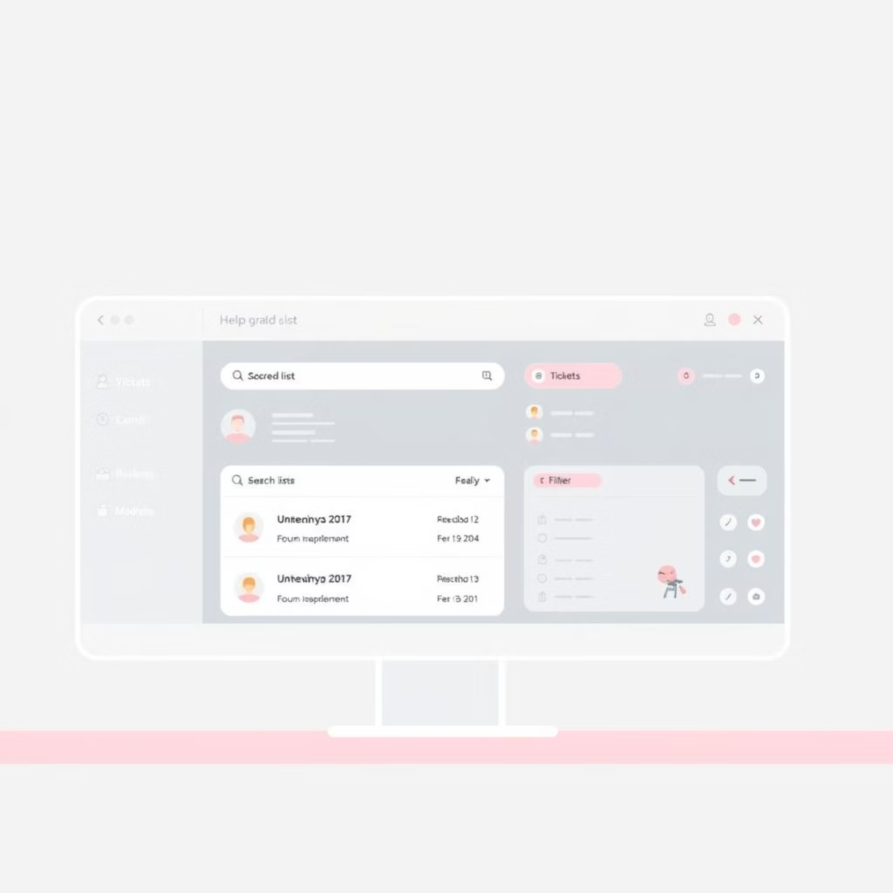
Intuitive End User Screens
The end-user experience in QuickDesk is designed for clarity and ease of use, ensuring they can efficiently manage their support needs.
Dashboard: Central hub with filters and search for quick ticket access.
Ticket Creation Form: Simple, guided process for submitting new issues.
Threaded Messages: Clear, chronological view of all communication within a ticket.
Profile Settings: Personalizable options for user preferences and information.

Slide 9
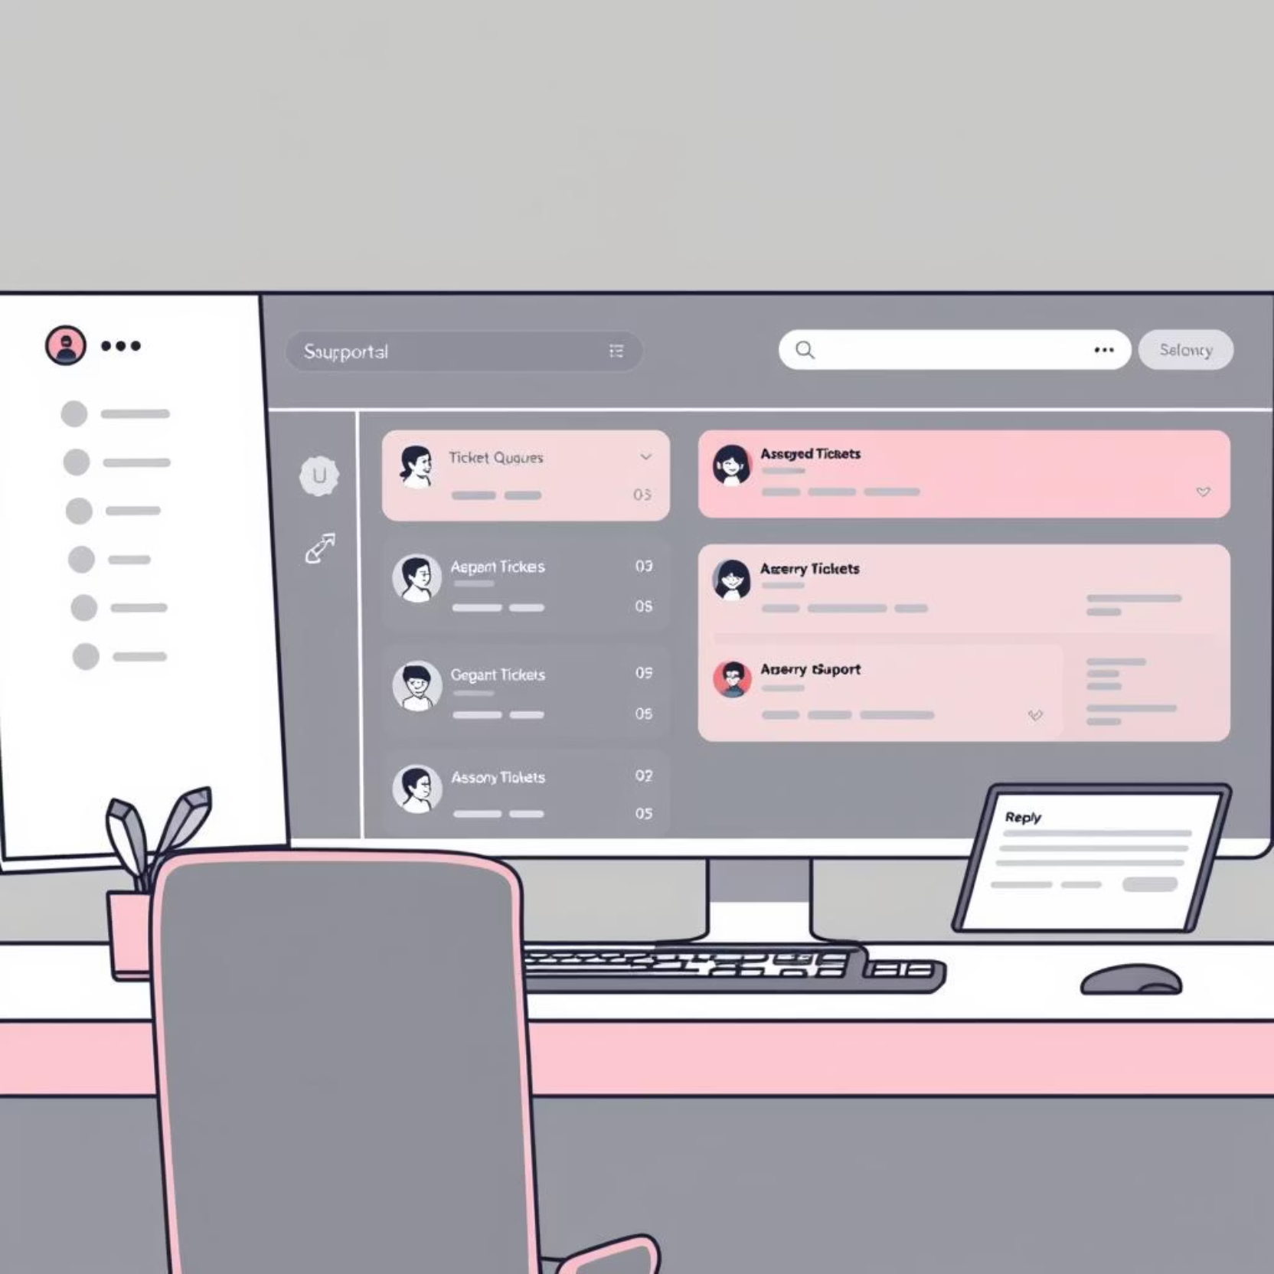
Efficient Support Agent Workflows
Support agents benefit from a powerful interface designed to optimize their workflow and accelerate issue resolution.
Multiple Queues: Organize and prioritize tickets based on urgency or category.
Assign/Update Tickets: Easy assignment to team members and real-time status updates.
Reply System: Integrated communication tools for seamless interaction with users.

Slide 10



Comprehensive Admin Features
QuickDesk provides administrators with robust control and oversight capabilities to ensure smooth operations and effective support management.
Role & Permission Management
Category Control
Ticket Statistics & Reporting
Customize and manage ticket categories to streamline organization and routing.
Define and assign custom roles with specific access levels to different users.
Gain insights into support performance with comprehensive ticket metrics and reports.

